Slide 1


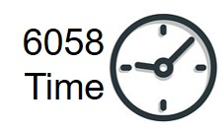





MGMT 6056 & 6058 Module 2
Some slides are exclusive to either 6056 or 6058
Exercises
Do the exercise prior to next slide
Videos
Solution Slide
PPT Animations
Exercise Simulation
Scope Management
Students will use MS Project and create a project file
See text in “slide note” for more details
Students will use Excel and create a worksheet

Slide 2
Module 2 Learning Objectives
Explain how Scope fits into Costs and the Schedule
Differentiate between Deliverables vs Activities
Create a WBS with Activities in MS Project
Compare different styles of the hierarchy
Understand what’s in an Excel WBS Dictionary
Identify common errors in creating a WBS in MS Project

Slide 3
Sections in this Module
The Scope Management Process as a predecessor to Cost Management and Schedule Management
Refreshing/building your math skills (specifically business math skills)

Slide 4
Section 1 The Scope Management Process – as a predecessor to Cost Management and Schedule Management

Slide 5
PMBOK Knowledge Areas & Process Groups
“Table 1-4. Project Management Process Groups and Knowledge Area Mapping” found on page 25 of the PMPBOK Guide V6

Slide 6
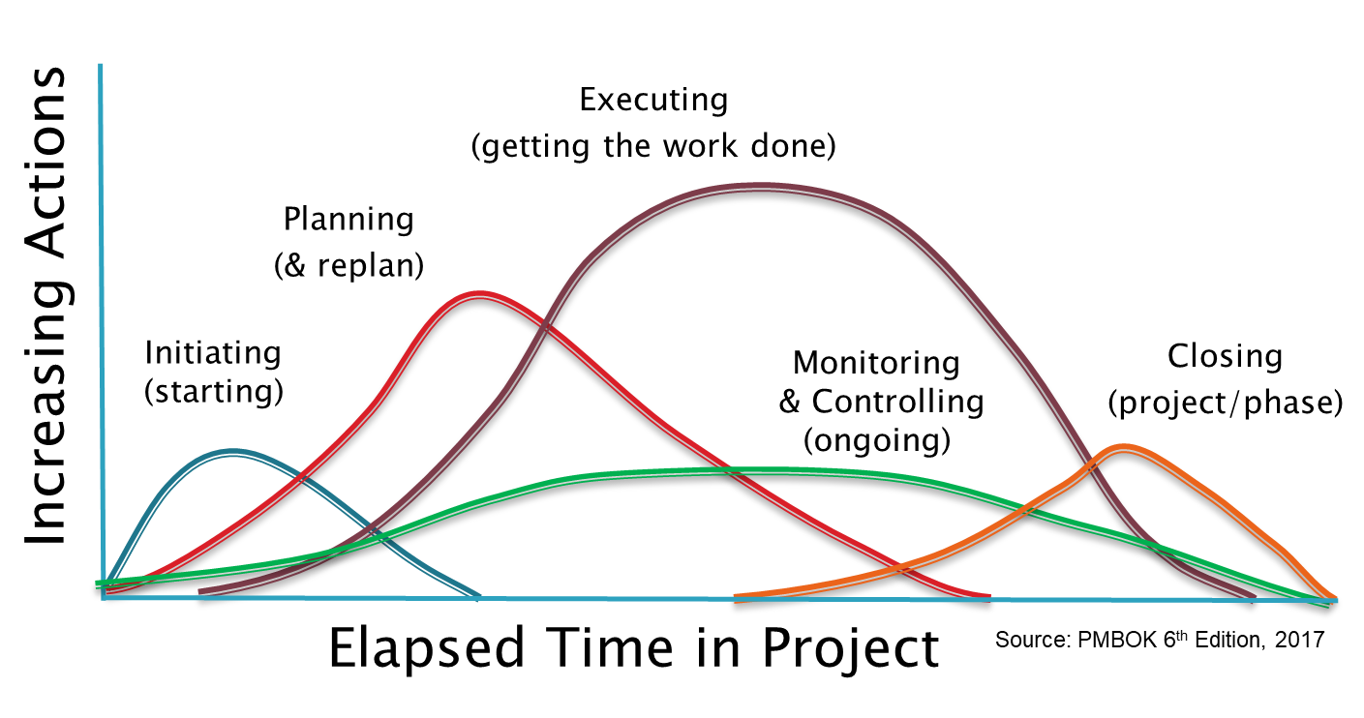
The PMBOK Process Groups and how they actually overlap during a project
Source: PMBOK 6th Edition, 2017
From the diagram on the right, process groups overlap in the project
Notes:
The curve for “Planning Processes” in the diagram on the bottom of the slide indicates that planning is performed almost to the end of the project. And “Monitor and Controlling Processes” are performed throughout the entire duration of the project.

Slide 7
What is Knowledge Area 5, Scope Management?
Scope - “the sum of the products, services, and results to be provided as a project” – “defining and controlling what is and is not included in the project”
Scope Statement
Description of the product, service or result, list of Deliverables, Project Exclusions (out of scope), and Acceptance Criteria (provides requirements for acceptance of our project deliverables)
Work Breakdown Structure (WBS)
“a hierarchical decomposition of the total scope of work … to achieve the project objectives” – we create a hierarchy of the total work – decomposing (breaking down)work into smaller and smaller pieces
WBS Dictionary
“document that provides detailed deliverable, activity, and scheduling information about each component in the WBS”
Source: PMBOK 6th Edition

Slide 8
What is a Statement of Work (SOW)
An SOW is a document that provides an overview of the project including the scope (the deliverables). It may include:
Key objectives of the project
Expected outcomes of the project
An abbreviated description of the scope (the things we want done, i.e. the work we want done) in the project
An introduction
Background of the project
An introductory technical description of the project
A high level timeline (e.g. an estimated duration)
Major milestones
Source: PMBOK 6th Edition

Slide 9
PMBOK and the Scope and Cost Knowledge Areas
We generally need to define
Scope before we can estimate costs and develop a budget in Cost Management
MGMT-6056 course is all about Cost Management!
Source: PMBOK 6th Edition

Slide 10
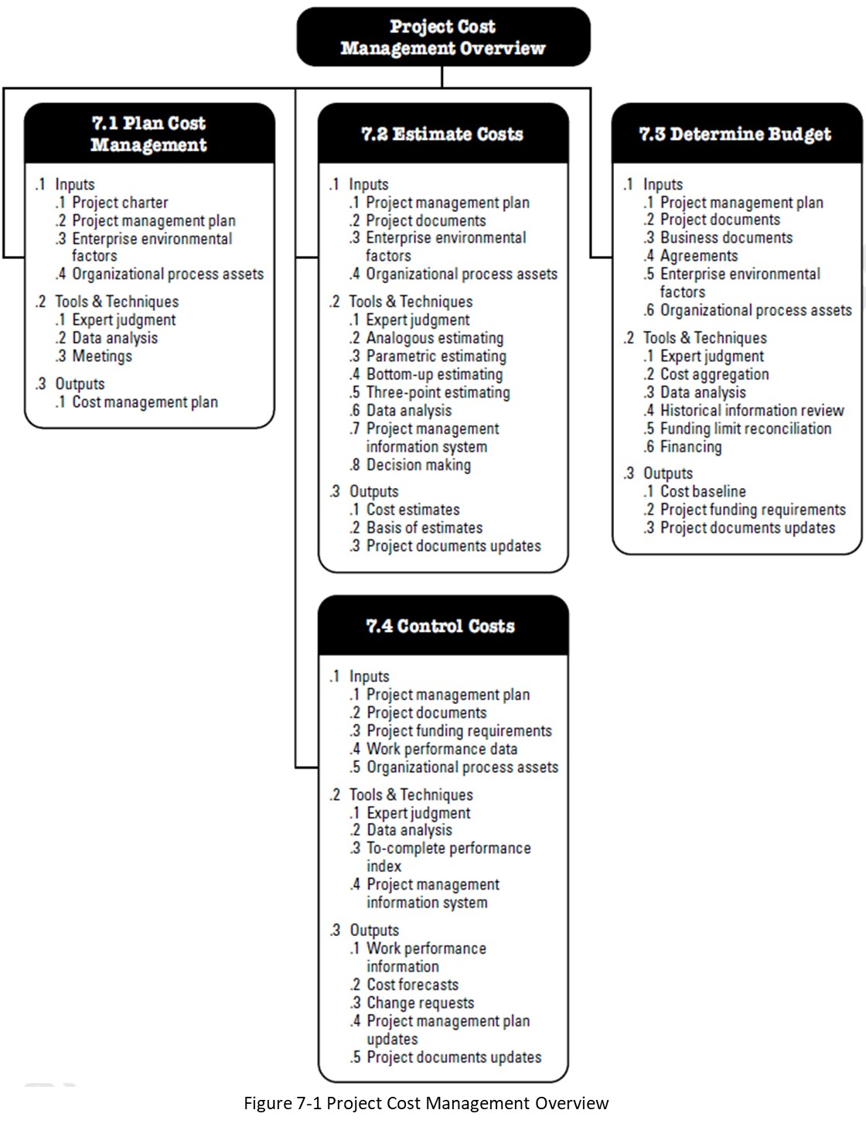
PMBOK Cost Management Knowledge Area
Scope is a key input into
Cost Management.
The project management plan includes all of the knowledge area plans, but also the Scope Baseline
Source: PMBOK 6th Edition

Slide 11
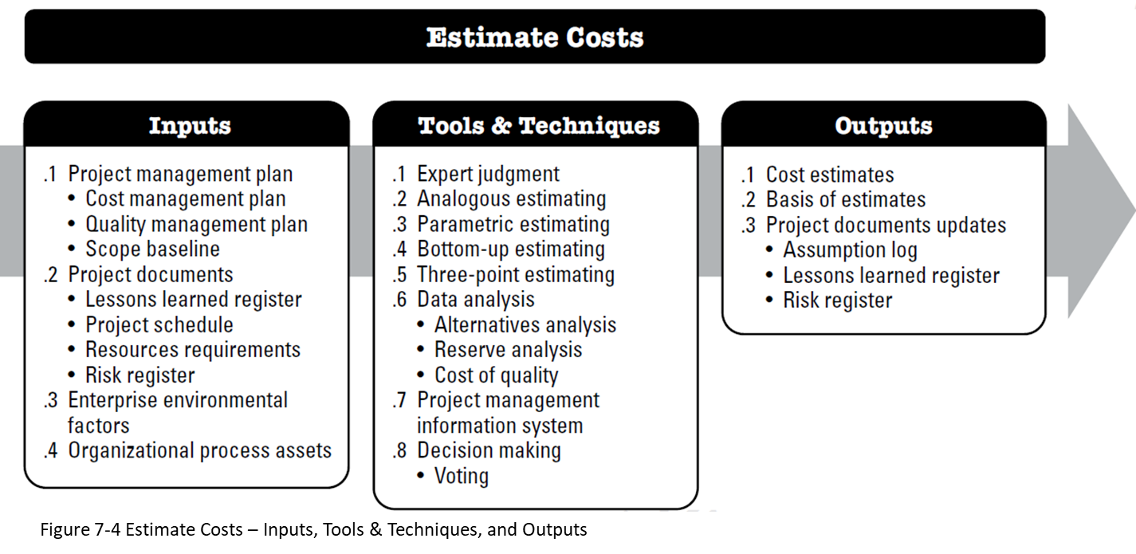
We first need Scope (the WBS is a key part of Scope) to start work on our Costs.
The Scope baseline
is the approved Scope (includes the WBS) and is an input to 7.2 Estimate Activities
Source: PMBOK 6th Edition, 2017

Slide 12
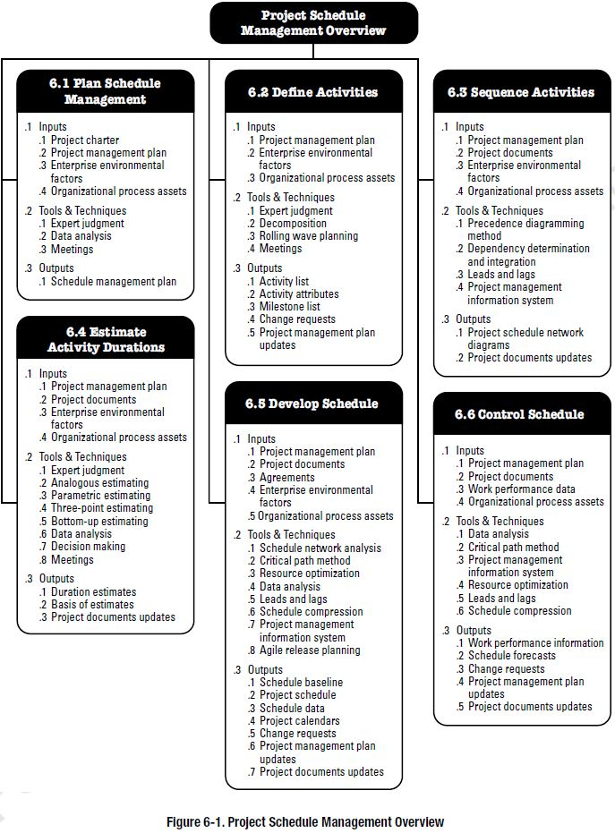
PMBOK Schedule Management Knowledge Area
Scope is a key input into Schedule Management.
The project management plan includes all of the knowledge area plans, but also the Scope Baseline
Source: PMBOK 6th Edition

Slide 13
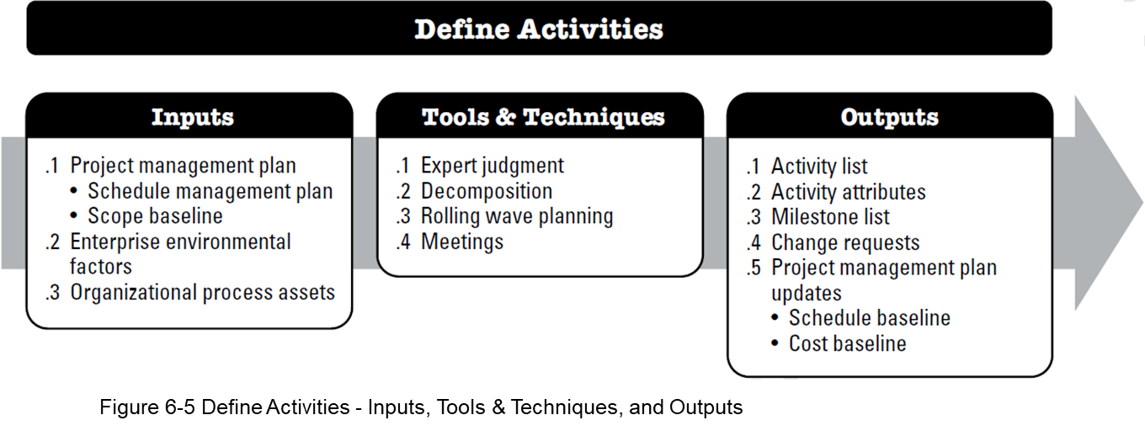
We first need Scope (the WBS is a key part of Scope) to start work on our schedule. The Scope Baseline - is the approved Scope (includes the WBS) and is an input to 6.2 Define Activities found in Schedule Management
Source: PMBOK 6th Edition

Slide 14
Work Breakdown Structure (WBS)
“A process that sets a project’s scope by breaking down its overall mission into a cohesive set of synchronous, increasingly specific tasks” (actually from a PMBOK perspective we would phrase this as increasingly specific deliverables).
What does WBS accomplish?
Echoes project objectives
Offers a logical structure
Establishes a method of control
Communicates project status
Improves communication
Demonstrates control structure
Project Management: Achieving Competitive Advantage, 3rd Edition, 2013
Notes:
The word task in project management is a very generic term. It can mean a single activity (the verb), it can also be used in the context of a deliverable. But most people think of a task as a verb, an activity. A WBS breaks down deliverables into increasingly specific deliverables, of which the most specific is the WP. We then assign activities to Work Packages.

Slide 15
Work Breakdown Structure and WBS Codes
The project deliverable is the overall project under development
1.0
1.2
1.3
1.4
Deliverables are major project components
1.2.1
1.3.1
1.2.2
1.3.2
Sub-deliverables are supporting deliverables
1.2.3
We are still “decomposing” this WBS but we are finished 1.2.3 so the green boxes are Work Packages as they are the lowest level in this part of the WBS
1.2.3.1
1.2.3.2

Slide 16
The Lowest Level Deliverable in the WBS is a Work Package
All elements/components of a WBS are deliverables that describe what you want in terms of scope, they are nouns
Lowest level in WBS
Deliverable result
One owner
Miniature projects
Milestones
Fits organization
Trackable
Why?
But the lowest level in the WBS is called a Work Package, and only Work Packages can have Activities -- Activities are NOT the what, but the how, they are verbs
Why?
Why? Example?
Notes:
We want one owner -- as we want one person responsible, we don’t want 3 people responsible who end up “pointing fingers” at each other (e.g. confusion and blame).
A work package should fit organizational procedures and culture -- the culture for a large organization could be that their minimum WP is at least 4 or 5 days long, not a day.
The optimal size of a work package may be expressed in terms of labour hours, calendar time, cost, reporting period, and risks – we might want our WP’s to be less than a week, but not more than $20K each, and if they are too risky, we want to make them smaller.

Slide 17
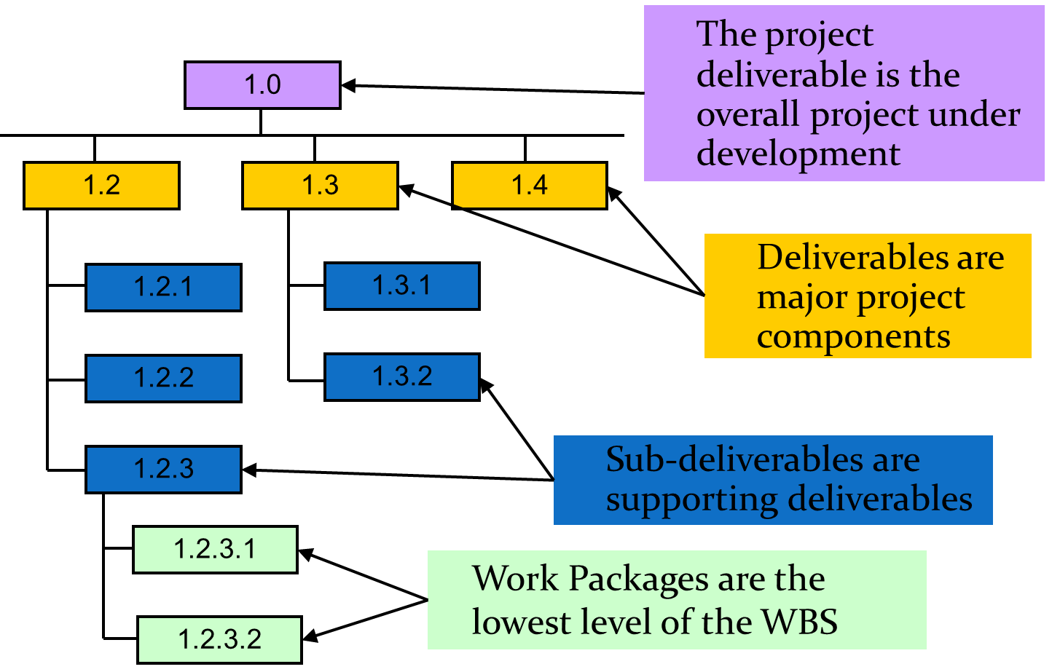
Work Breakdown Structure and Codes
Work Packages are the lowest level Deliverables in each branch of a WBS and the only Deliverable type that can have Activities
Activity 1
Activity 2
Activity 3
Each WP (a noun) needs Activities to make it happen (verbs)
Activities define the necessary resources and duration and cost
The Work Package can have summary information from the Activities e.g. total cost for all the Activities in the WP
Activities are usually not shown as “boxes” in a WBS diagram

Slide 18
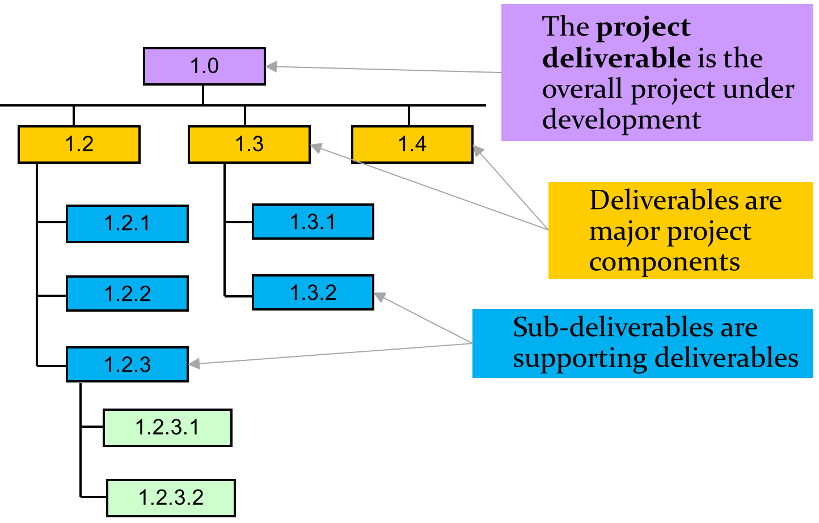
Work Breakdown Structure and Codes
Work Packages are the lowest level Deliverables in each branch of a WBS and the only Deliverable type that can have Activities
1.2.3.1.1 Activity 1
1.2.3.1.2 Activity 2
1.2.3.1.3 Activity 3
Each WP needs Activities to make it happen
Activities are usually not shown as “boxes” in a WBS diagram
WP’s are deliverables (nouns) vs activities (verbs)

Slide 19
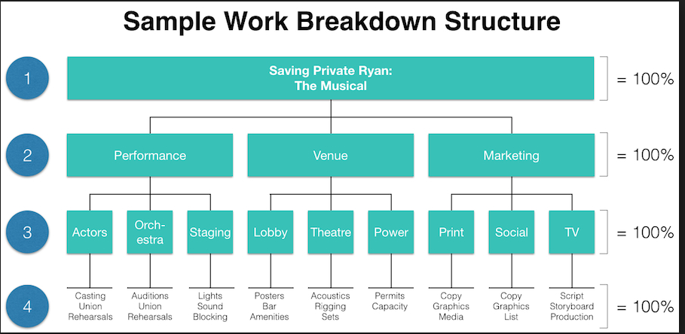
Work Breakdown Structure - Resources
Work Package vs Activity – scroll to the table “Final Thoughts – Difference …”
How to draw a Work Breakdown Structure in less than a minute 1:07

Slide 20
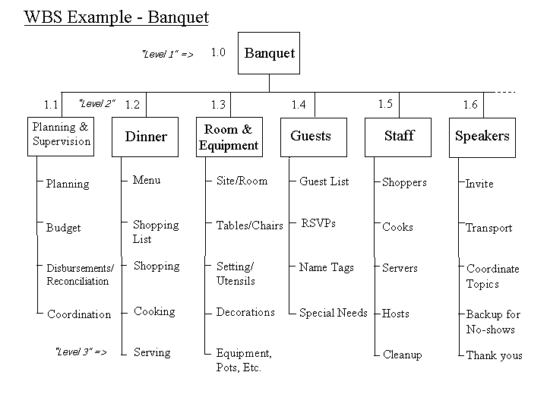
Another Example of a Graphical WBS
Difference between WBS proper -- and Activities?
Notes:
Typically, the WBS elements including the Work Packages are drawn as boxes with lines, and Activities are drawn without lines (just text). This way it’s clear that anything that is a box is a deliverable and just text is an Activity. If we don’t follow this convention, it can become confusing.

Slide 21
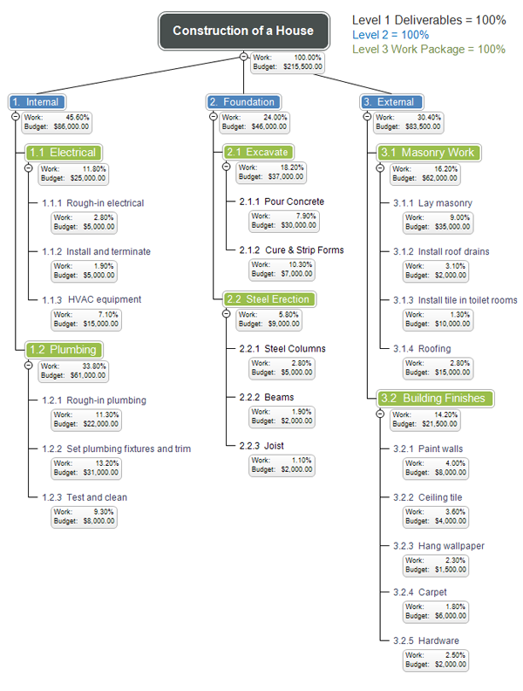
Another
Example
Another example of a graphical WBS
Note in this WBS, these boxes are just notes, not deliverables nor activities
Note, in previous slides the project was level 1, in this example the project is not numbered but is essentially level 0

Slide 22
IV. UTILITIES
A. Electrical
1. Rough In
2. Building inspection
3. Finish work
B. Plumbing
1. Rough in
2. Building inspection
3. Finish work
C. Gas
1. Rough in
2. Building inspection
3. Finish work
V. WALLS
A. Hang sheetrock
B. Tape and bed
VI. ROOFING
A. Install sheathing
B. Lay shingles
VII. FINISH WORK
A. Interior
1. Install cabinets
2. Install appliances
3. Install furnace
4. Lay carpet
5. Paint walls and molding
6. Hang wallpaper
7. Lay tile
VIII. LANDSCAPING
Another WBS for the Construction of a House
Note a different type of WBS Code naming convention that does not convey the WBS levels as well.
I. SITE PREPARATION
A. Layout
B. Grading
C. Excavation
II. FOUNDATION
A. Erect Forms
B. Pour Concrete
C. Remove Forms
Ill. FRAMING
A. Floor Joists
1. Install first‑floor floor joists
2. Install second‑floor floor joists
B. Sub-flooring
1 Install first‑floor sub-flooring
2. Install second‑floor sub-flooring
C. Stud Walls
1. Erect first‑floor stud walls
2. Erect second‑floor stud walls
D. Frame Roof
Can you easily tell which is an Activity and which is a WP/Deliverable in both section II and section III?

Slide 23
The Work Breakdown Process: From the Top Down
What about bottom up?
First identify the project. (Level 1)
Second identify the major components / deliverables of work to be accomplished. (Level 2)
Physical Decomposition – product building with summary approach
Functional Decomposition – system functionality focus
Design-Build-Test-Implement – methodology or lifecycle phase focus
Objectives – senior management or customer focus on reporting to deliverables
Geographical – coordination and communication focus across locations
Business Function – focus on business process with integration complications
Departmental – focus is on organizational control of one manager
Identify the next level of work (Level 3) under each major component and list them under their top-level groups. Often sub-deliverables.
Continue to break down the work under each Level 2 items to the lowest level that can be comfortable managed. (Levels 3 and 4+)
Notes:
You can also create a WBS but starting with activities, grouping them into WP’s, and grouping WP’s into minor subdeliverables, then major subdeliverables, and then a single project level deliverable.

Slide 24
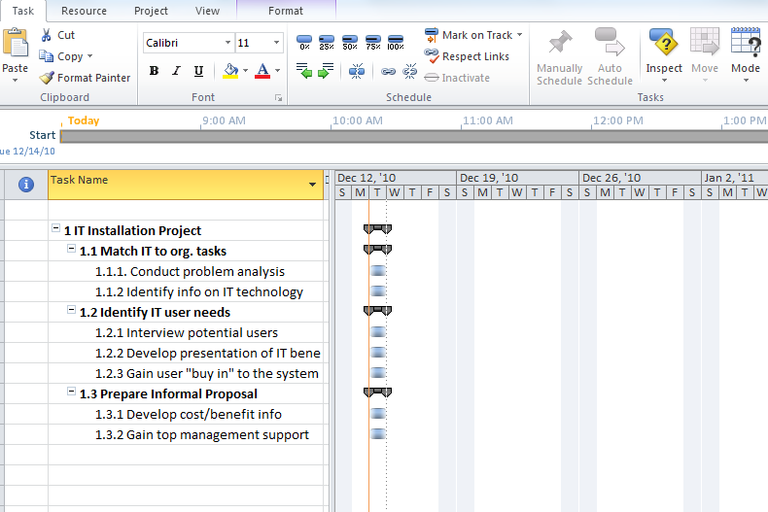
Create a WBS in an MS Project File (also called an MSP file or a .mpp file) Enter WBS components and Activities
Enter the “WBS elements to the left” into a blank MSP file, we will use indents to group our tasks.
Why are we using the term “task” when it is has multiple meanings in industry?
There is a difference between a WBS deliverable and an activity.
Figure 5.7

Slide 25
Create a WBS in an MS Project File (.mpp file) Enter WBS components and Activities
Enter all the task names, don’t enter the WBS Code, MSP will do this for us.
Enter an arbitrary duration of 2 days for Activities so we can see it graphically
Use the indent button
Make the Task Name column wide enough
Turn on WBS Code, use the Format tab, then Outline Number
Convert the Deliverables (Summary Tasks in MSP terms) into nouns
Highlight colour the Activities light blue, the WP’s yellow, and higher level deliverables green
Figure 5.7
If you don’t have MS Project installed create the WBS in Excel. Use a separate column for your WBS code, and use the indent button to show hierarchy.
MS Project uses only Summary Tasks and Detailed Tasks, the former are deliverables, the latter Activities
Colour coding of tasks is for learning purposes only and is not done in business situations

Slide 26
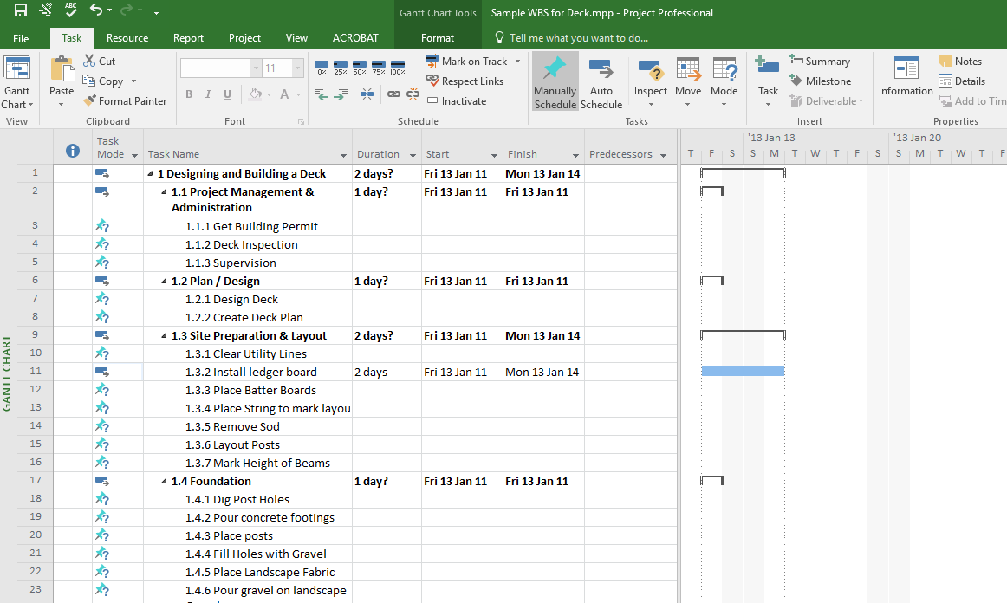
An Example of a WBS with Activities in MS Project (.mpp file)
This particular project only has 2 levels of Deliverables plus an Activity level for a total of just 3 levels including Activities. Note, we use WBS’s with Activities in this course.
Summary Tasks in MSP we have this symbol and the task name is automatically bolded by MSP. They represent a “Deliverable” at various levels in the WBS.
We control the levels of the WBS by using the indent and outdent buttons.
Detailed Tasks in MSP will show in this Gantt chart as a symbol only if they are given a duration. They represent an Activity. We enter details manually, such as durations in these Detailed Tasks. Durations for Summary Tasks are calculated automatically by MSP (hence the name “summary”) based on the Detailed Task (Activity) durations.
Typically there are multiple Activities in a WP
Activities are only found below (and indented) a Work Package (WP). A WP is a special Deliverable, it is the lowest level Deliverable in any branch of the WBS.

Slide 27
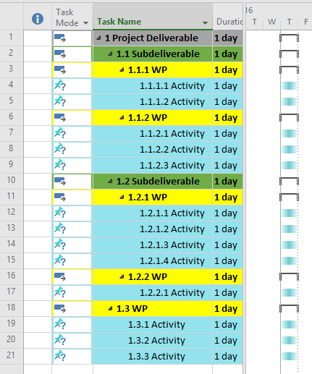
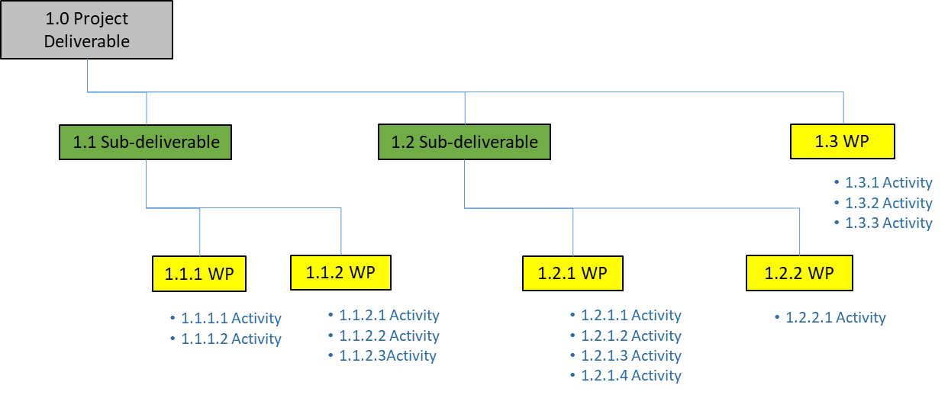
How Do We Move a Hierarchical WBS with Activities, into MS Project?
MS Project screenshot
Note: the colour coding of deliverables and activities in the MS Project screenshot, is for learning purposes only.

Slide 28
First We Make Sure We Don’t Have Activity Errors in our WBS! Example Hierarchical WBS with Activities – No Errors
1.0 Project Deliverable
1.1 Sub-deliverable
1.2 Sub-deliverable
1.3 WP
1.3.1 Activity
1.3.2 Activity
1.3.3 Activity
1.1.1 WP
1.1.2 WP
1.2.1 WP
1.2.2 WP
1.1.1.1 Activity
1.1.1.2 Activity
1.1.2.1 Activity
1.1.2.2 Activity
1.1.2.3Activity
1.2.1.1 Activity
1.2.1.2 Activity
1.2.1.3 Activity
1.2.1.4 Activity
1.2.2.1 Activity
Note: the layout of this WBS has been skewed graphically in order to make the next slide clearer.
A generic deliverable, such as the Project Deliverable, can have deliverables (the two Sub-deliverables) as well as a Work Packages.

Slide 29
Example MS Project WBS with Activities – No Errors

Slide 30
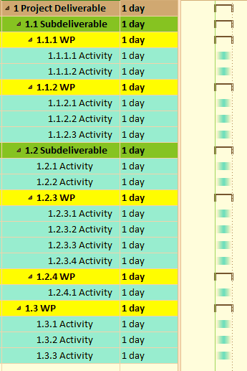
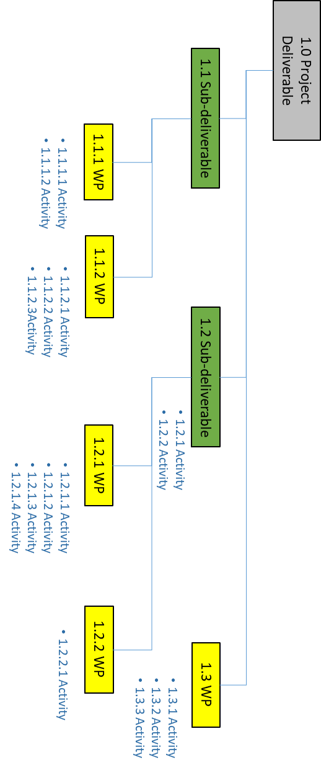
Can you find it on the left side?
We’ve Created an Error in MS Project
What about the right side?

Slide 31
Here is the Error, it is most visible in a hierarchical WBS - Activities are attached to a Subdeliverable but shouldn’t be
1.0 Project Deliverable
1.1 Sub-deliverable
1.2 Sub-deliverable
1.3 WP
1.2.1 Activity
1.2.2 Activity
1.3.1 Activity
1.3.2 Activity
1.3.3 Activity
1.1.1 WP
1.1.2 WP
1.2.1 WP
1.2.2 WP
1.1.1.1 Activity
1.1.1.2 Activity
1.1.2.1 Activity
1.1.2.2 Activity
1.1.2.3Activity
1.2.1.1 Activity
1.2.1.2 Activity
1.2.1.3 Activity
1.2.1.4 Activity
1.2.2.1 Activity
Activities can only be attached to WP’s. An additional WP would have to be created below 1.2 (it could be called 1.2.2), and would have the two Activities attached to the Sub-deliverable 1.2.

Slide 32
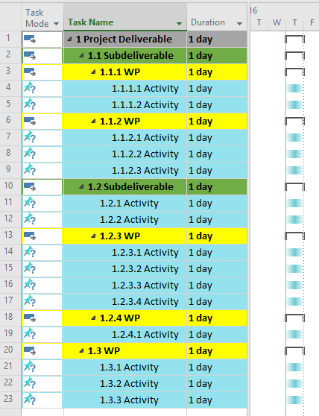
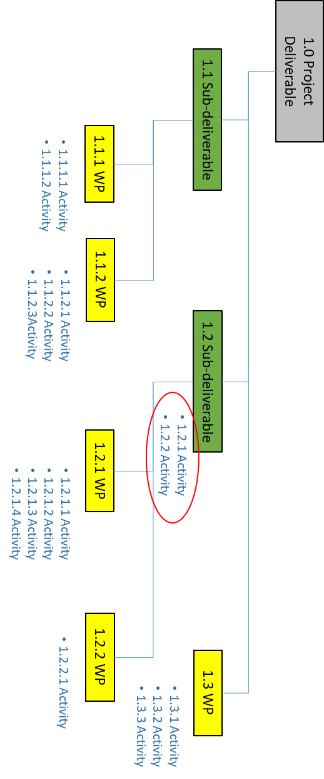
Same Error but Note it’s Less Visible in MS Project but Colour Helps
Notes:
Although the error is less visible in the MSP screenshot on the left, it becomes somewhat more visible through the use of colour coding, which we use in this course for learning purposes.

Slide 33
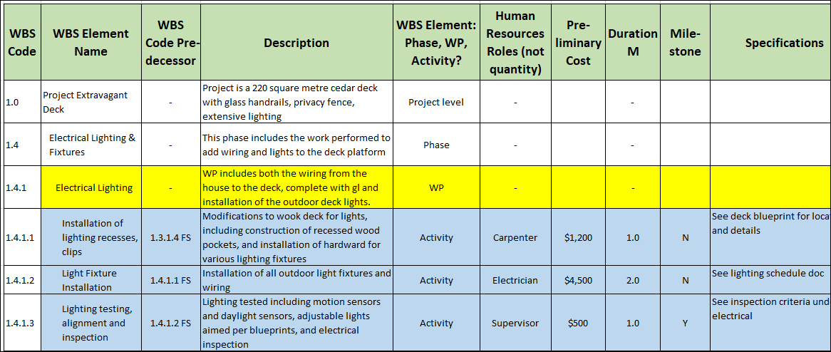
WBS Data Dictionary
A WBS Data Dictionary provides detailed information on the Elements in the WBS graphical hierarchy.
Below is an Excel example, the headings of the columns can vary widely depending on the project.
It can contain information such as: WBS codes, durations, costs, resource assignment, predecessors, and both deliverables and activities

Slide 34
Section 2 Math Review and Business Math

Slide 35
How to Safely Convert Between Units
Work your way through the 3 examples in this webpage https://www.mathsisfun.com/measure/unit-conversion-method.html
Try the first 5 questions at the bottom of the page
Try this business problem: We want to order a custom carpet for our company board room. The customer carpet will be cut to 3m by 7m. The cost for the carpet will be $12/sq ft. The outer edges of the cut carpet will need binding (or it will unravel) and the cost is $15 for each yard of carpet. HST is 13%, how much is our carpet?
Notes:
The area of the carpet is 3m x 7m or 21 sq metres. There are 3.28084 ft in a metre. Which means there are 3.28084 ft/metre x 3.28084 ft/metre or 10.764 sq ft in a sq metre. The price of the carpet is 12/sq ft. So the cost per sq metre will be $12/sq ft x 10.764 sq ft/sq m = $129.17/sq metre. We need 21 sq metres so $129.17/sq x 21 sq metres = $2,712.57
The outer edge of the carpet will be 2 x 3m plus 2 x7m = 20 metres. The price of binding is $15/yard. ($15/yard) / (3ft/yard) = $5/ft. $5/ft x 3.28084 ft/metre = $16.404/metre. We have 20 metres that need binding so $16.404/metre x 20 metres = $328.08
The sum of the carpet and binding is $2,712.57 + $328.08 = $3,040.65. With HST that’s $3,040.65 x 1.13 = $3,435.94

Slide 36
Weighted Mean (or Weighted Average)
Work your way through this webpage https://www.mathsisfun.com/data/weighted-mean.html
Make sure you try #5, 7, 8 & 10 as these are examples using student grades
Try this GPA problem. You finished 6 courses, and your course percent scores were 78, 64, 61, 74, 54, 52. The first four courses are 3 credit hours and the last two are 4 credit hours. What is your GPA for these 6 courses?
Range | Letter Grade | Grade Point
90% - 100% | A+ | 4.2
80% - 89% | A | 4.0
75% - 79% | B+ | 3.5
70% - 74% | B | 3.0
65% - 69% | C+ | 2.5
60% - 64% | C | 2.0
55% - 59% | D+ | 1.5
50% - 54% | D | 1.0
0% - 49% | F | 0.0
Notes:
Course Score Letter Grade Grade Point Course Hrs GPA * Course Hrs
78 B+ 3.5 3 10.5
64 C 2.0 3 6
61 C 2.0 3 6
74 B 3.0 3 9
54 D 1.0 4 4
52 D 1.0 4 4
Totals > 20 39.5
Weighted GPA 1.975 < 2.0
Note, you need a minimum 2.0 Weighted GPA to pass most Graduate Certificates

Slide 37
Linear Equations
Work your way through part of this webpage, STOP before “Point-Slope Form” https://www.mathsisfun.com/algebra/linear-equations.html
Try the business problem: We want to figure out the cost when we place re-orders for some USB storage drives for our office. These are special drives and cost $256 each. Sometimes we order just one, sometimes more, but regardless of the size of the order we have to pay $19 for shipping. What is the formula to determine the price of the order (the linear equation Y = mx + b)? How much for an order of 4?
Notes:
Y = mx + b
Cost of Order = $256 x “# of Drives” + $19
How much for an order of 4?
Cost of Order = $256 x 4 Drives + $19
= $1024 +$19
= $1,043

Slide 38
Line Graphs
Work your way through this webpage https://www.mathsisfun.com/data/line-graphs.html
Try all 10 of the questions, they are short! #1 uses interpolation #5 uses extrapolation #8 is tricky, read the question very carefully #10 requires the use of percent

Slide 39
Interpolation and Extrapolation Definitions
Check out these two webpages Interpolation Definition https://www.mathsisfun.com/definitions/interpolation.html Extrapolation Definition https://www.mathsisfun.com/definitions/extrapolation.html
We use Extrapolation in Project Management to forecast the performance of the project

Slide 40
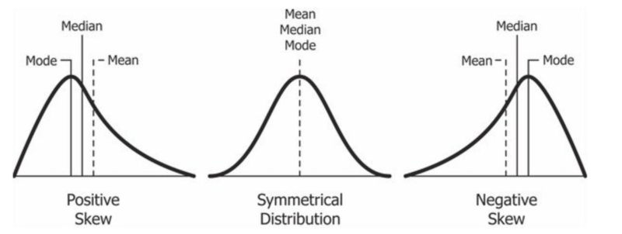
Finding a Central Value
Work your way through this webpage, but STOP before “Other Means” https://www.mathsisfun.com/data/central-measures.html
Although the 3 central values (mean/median/mode) are identical in the symmetrical distribution below, in project management we frequently work with positive skews, so the 3 different measures become very useful.
Retrieved from https://en.wikipedia.org/wiki/Skewness
Notes:
The median is frequently described as placing all of the numbers in order from low to high, and then picking the middle number. Another way of describing it is the median is the number in the ordered set of numbers where 50% of the numbers are less than the median and 50% are higher than the median.

Slide 41
Business Math Skills – FOL Quizzes
The math skills required for these courses are primarily “business math”. The context of the question is important in order to understand what is being asked. Start assessing your skills now, complete the set of M1 Practice Quizzes – you need to know your skill level.
In FOL, under Content/Getting Started and Resources, you will find an additional quiz resource, “Business Math Practice Questions from Quizizz.com”. These quizzes will also help you to assess your business math skills.
There are some FOL Practice Quizzes with module math Questions available throughout the course. These are unlimited attempts with scores provided immediately after you finish.
If you score a 2 out of 4, and you want to know which ones you didn’t get correct, you can take the quiz again answering just one question. If you got 1 point for your score, you know you answered it correctly.
You may find that you are “rusty” in math in which case the Library Learning Commons offers free math help. https://www.fanshawelibrary.com/drop-in-math/

Slide 42
Summary of Module
Explain how Scope fits into Costs and the Schedule
Differentiate between Deliverables and Activities
Create a WBS with Activities in MS Project
Compare didn’t styles of hierarchical
Understand an Excel WBS Dictionary
Identify common errors in creating a WBS in MS Project

Slide 43
Homework
Both courses:
Refer to the Start Here section of this module
Review PPT files with solutions
Assignments, practice quizzes and graded quizzes, check the Course at a Glance and FOL/Content/Course Assignments & FOL/Evaluations/Quizzes
Read for next module in 6056 Cost:
Kerzner 12th Ed 378-379, 463-466, 11th p 546-547, 690-695
PMBOK 6th Ed 7.1, 7.2
Read for next module in 6058 Time:
Kerzner 12th Ed p 409-431, 11th p. 597-620
PMBOK 6th Ed 6.1, 6.2, 6.3, 6.4

Slide 44


